Slide 1

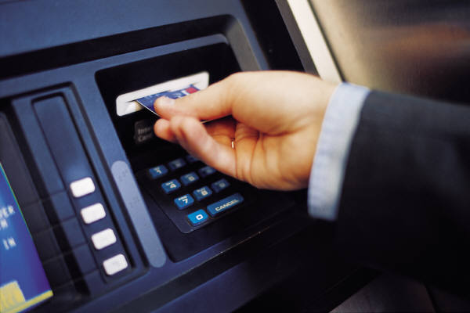
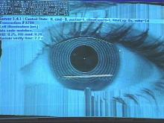
AN ATM WITH AN EYE
THE FUTURE’S TECHNOLOGY
PRESENTED BY
CH.KARTHIK DATTU
151FA04011
CSE-B
1

Slide 2
CONTENTS
ATM
ATM WITH AN EYE
WORKING
TECHNIQUES
FUNCTION
PROTECTION
WHERE IT IS USED
CONCLUSION
REFERENCES
2

Slide 3
AUTOMATED TELLER MACHINE
An automated teller machine (ATM) is :
Computerize telecommunications
Made money transactions easy for customers through bank.
Device that provides the customers of financial transactions in a public space without the need for a human clerk or bank teller.
Security concern is cleared as it requires a combination of both physical acess of card and PIN for transaction.
3

Slide 4
PERSONAL IDENTIFICATION
NUMBER (PIN)
PIN is one method used by banks and phone
companies to protect your account from unauthorized
access
PIN is a confidential code issued to the cardholder to
permit access to that account
PIN should be memorized, secured and not given to
anyone, not even family members or bank employees
4

Slide 5
AN ATM WITH AN EYE
The chances of misuse of this much hyped 'insecure' baby product (ATM) are manifold due to the exponential growth of 'intelligent' criminals day by day.
There is an urgent need for improving security in banking region. With the advent of ATM though banking became a lot easier it even became a lot vulnerable.
Provide a cordless, password-free way to get their money out of an ATM
5

Slide 6
WORKING
By forcing the ATM
match a live image of a customer’s face/eye with an image stored in a bank database (associated with the account number)
when the data matches(account image and stored image)
user be considered fully verified
A system can examine just the eyes, or the eyes nose and mouth, or ears, nose, mouth and eyebrows, and so on.
6

Slide 7
WORKING(Contd.)
A camera based in cash machine will
Detect the pattern in second
Compare it with one store in a central computer.
Or encode on to the cash card.
A sensor system examines the randomly
Formed features of the iris of the eye
as unique as a fingerprint.
7

Slide 8
BIOMETRIC IDENTIFICATION TECHNIQUES
Finger Printing
Retina Scanning
Facial Recognition
Iris Recognition
8

Slide 9
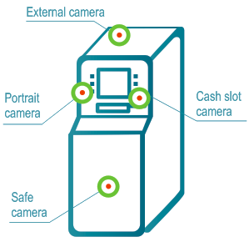
Camera Installation On ATM
Machine
9
FIGURE-4

Slide 10
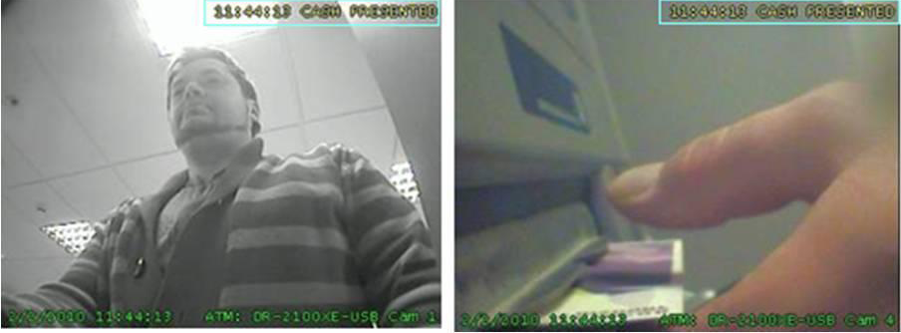
Camera Snapshots
Portrait camera
Cash slot(Dispenser) camera
FIGURE-5
10

Slide 11
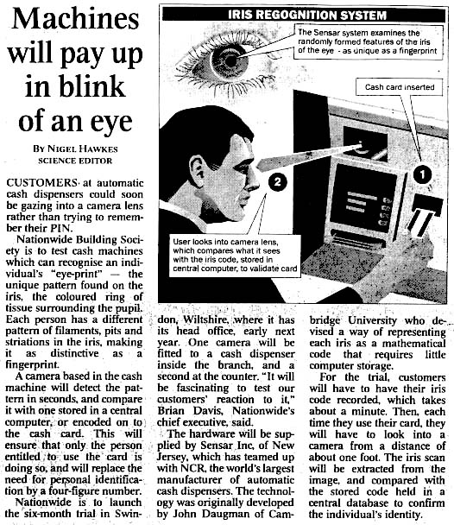
Function
Machines will pay up in blink of an eye
Users looks into camera lens,which compares what it sees with iris code stored in central computer to validate card.
The sensor system examines the randomly formed features of the iris of the eye as unique as a fingerprint in seconds
15/03/11
11
11

Slide 12
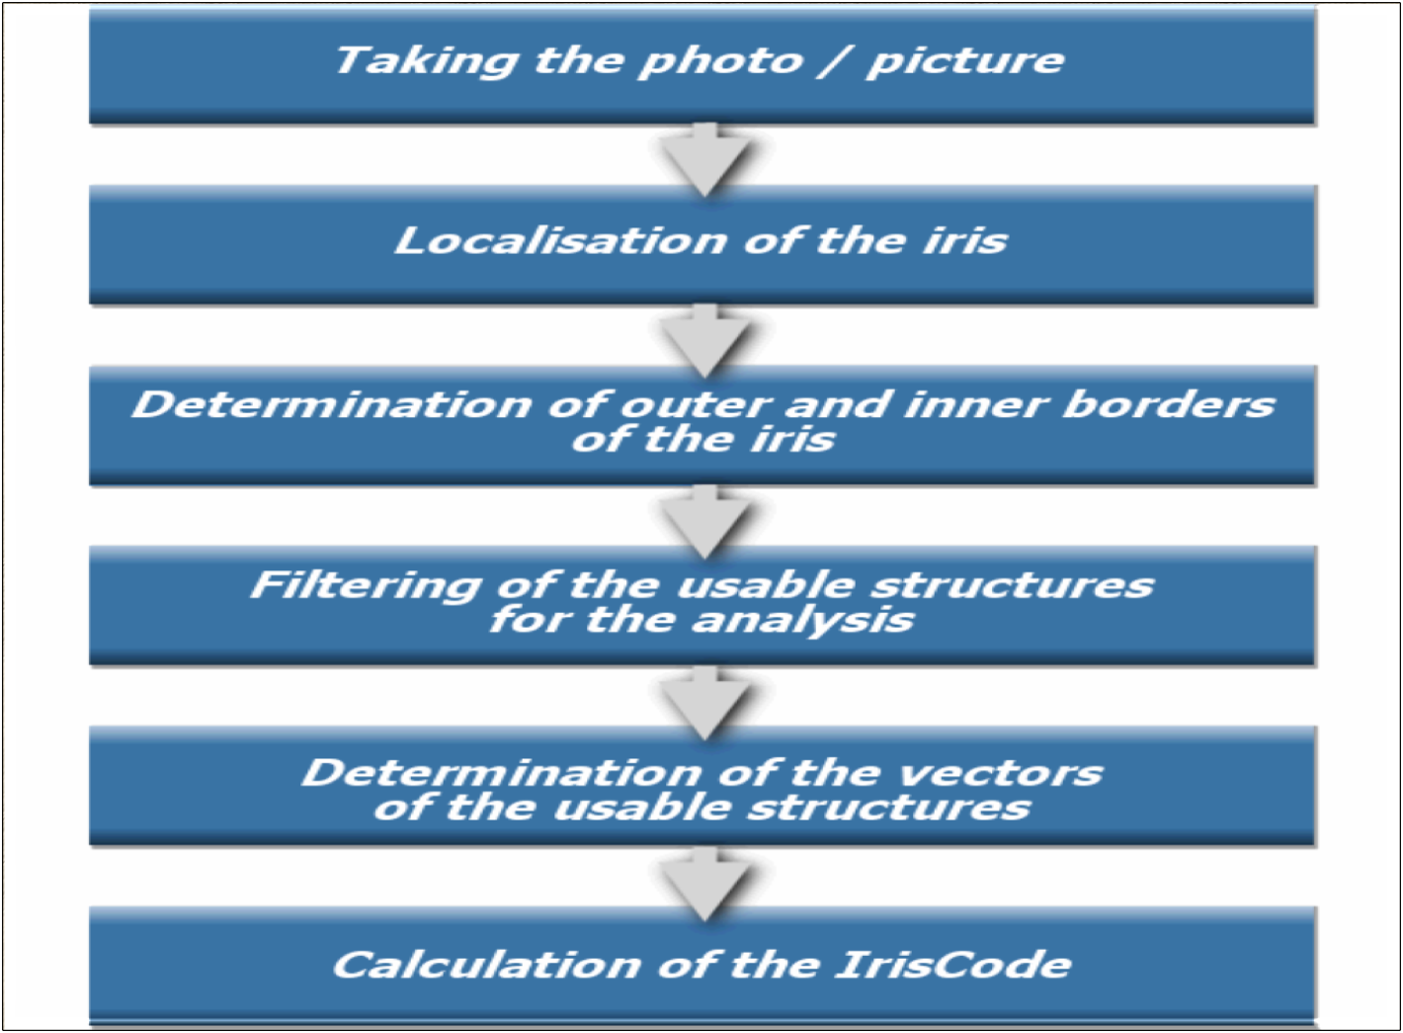
Steps Of Iris Working
12

Slide 13
Troubleshooting
EYE automatically discover SNMP enabled devices, application servers and applications. EYE has up-to-date and accurate end-to-end visibility on what’s happening on your infrastructure.
FIGUR
13

Slide 14
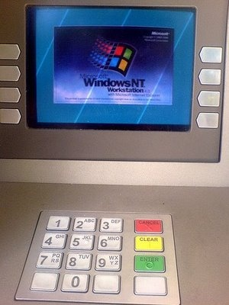
Where It Is Used
FIGURE-3
The development of such a system would
serve to protect costumers
financial institutions alike from fraud
other breaches of security.
14

Slide 15
CONCLUSION
We thus develop an ATM model which is more reliable in providing security by using facial recognition software.By keeping the time elapsed in the verification process to a negligible amount.Try to maintain the efficiency of this ATM system.
15

Slide 16
REFERENCES
www.wikipedia.org
www.ieee.org
www.computer.org
www.logictech.org
www.technologyreview.com

Slide 17


17

Slide 18
QUERIES??
18

